Slide 1
Top 4 issues in 2020
Consultants Submitting on Behalf of a Utility
Incomplete Submittals
PED Detours
Expiring Permits/ Work Completed

Slide 2
Consultants submitting permits
Prior to creating a user outside your organization, an “Applicants Authorization for Agent to Apply for Utility construction Permit” form is required to be completed and submitted to Eric Cimo.
Once done. The Utility MUST upload the user (Not DelDOT) It is important to know who your Administrator is within your organization.
TRAIN the new user PRIOR to giving them access.

Slide 3
Provide Consultant with a checklist, example of the sketch/plans and description of work.

Slide 4
Oversee the work being submitted.

Slide 5
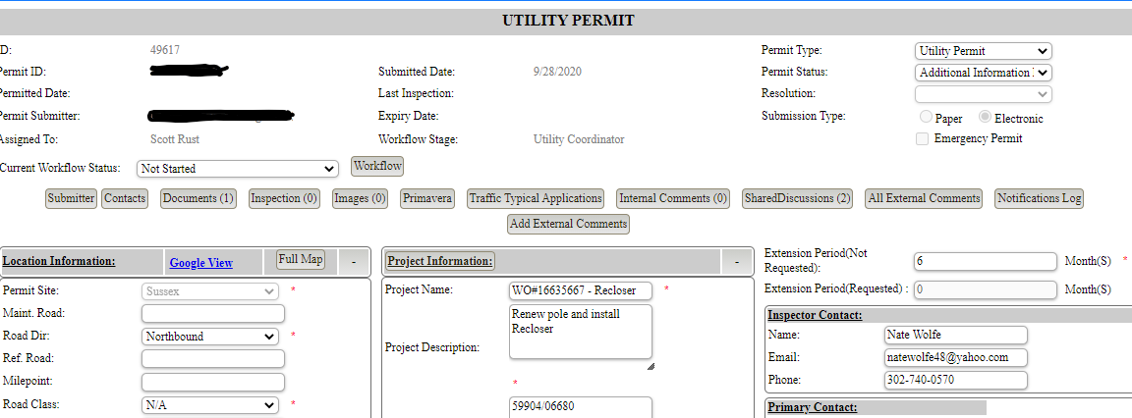

Slide 6
SC-0035-20DC---1812735
NEAREST INTERSECTING RD. SRD 594(WEBBS FARM RD) IS 561’ EAST OF EX. POLE 619
CHANGE OUT EX. POLE 619- 31’ SOUTH C/L SRD 224
BORE 44’ NORTH FROM EX. POLE 619
PLOW 24’ EAST E3.O.P. 11’
SRD 224- STAYTONVILLE RD- PAVED 22’- R/W 60’, GRASS SHOULDERS

Slide 7
Highlight areas that do not meet Deldot standards or where constructability conflicts exist
During design if there are items/areas that do not meet DelDOT standards, outline these items and reason why with a hardship request if you’re proposing to deviate from the design standard. (Typically plans are submitted without this and DelDOT is left to identify all the non-conforming areas, despite the fact the submitter knows its non-compliant.)
Diagonal Drill Crossings.
Insufficient Pavement Section
Placement of the Utility (above ground clear zone issues/below ground horizontal placement in the R/W)
Showing a jack and bore without the ability to install pits due to no ROW or Easement

Slide 8
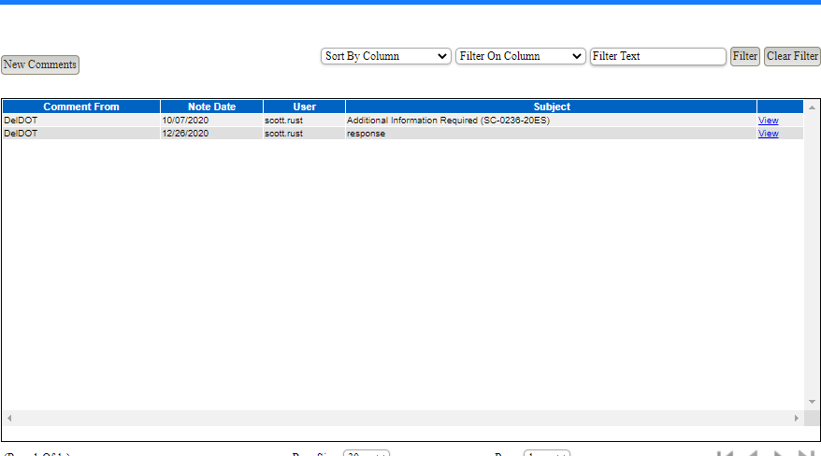
What's a reasonable turn around time for responses?
Respond timely and click the resubmit button to move your permit from “Additional Information” back to “In Progress”. It tells us you have responded.

Slide 9
Ped Detours….Is it as simple as putting a TA-28 on the permit????

Slide 10
No…. it usually isn’t that easy.
It is important to know the area you're working in and what's involved in the scope of work.
Typically, the engineer/agent submitting the permit really doesn’t know what's involved in performing the work. (i.e. means and methods).
If TA-28 is placed on the permit as a blanket TA, field conditions may not be as simple as the TA outlines in the manual. This causes delays during construction which may require a pedestrian plan to be submitted and approved prior to start of work or force a project to night work or extensive temporary pedestrian improvements.

Slide 11
Whose responsibility is it to ensure the pedestrian detour is in place and correct?

Slide 12
The permit holder/utility & the contractor performing the work

Slide 13
So…is placing a blanket TA-28 To the permit reasonable?? No…. it usually is not.
At minimum if you place a TA-28 on the permit you need to have looked at the location to determine if it is applicable .
If you cannot make it work, then submit a plan for review outlining your path.

Slide 14
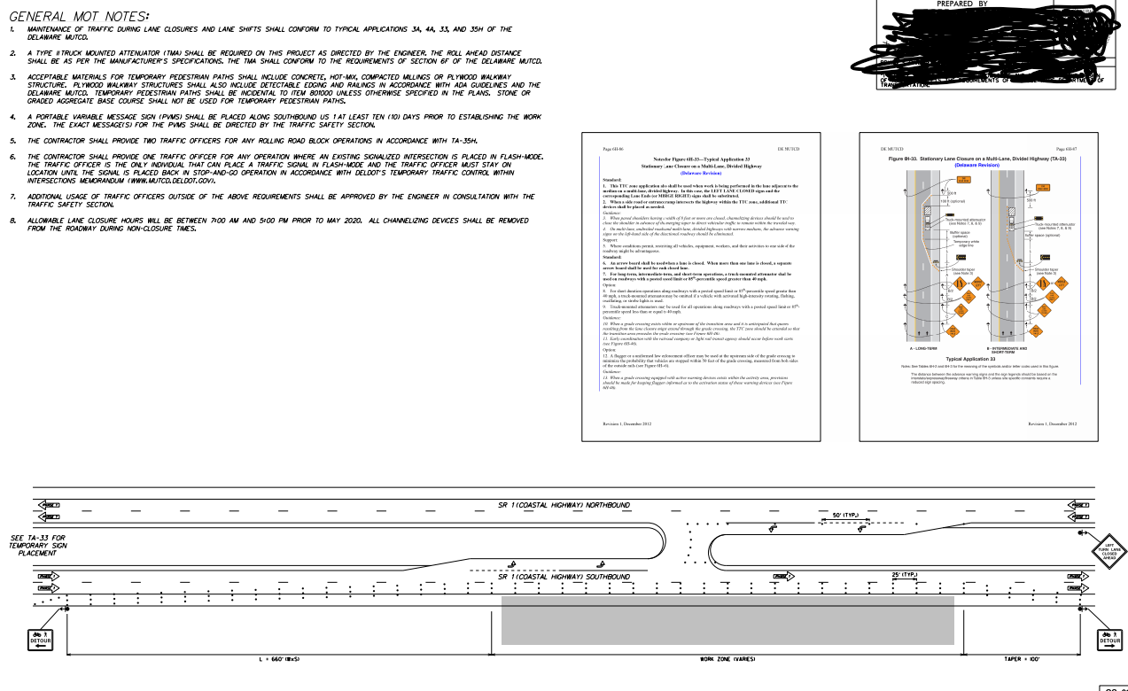

Slide 15
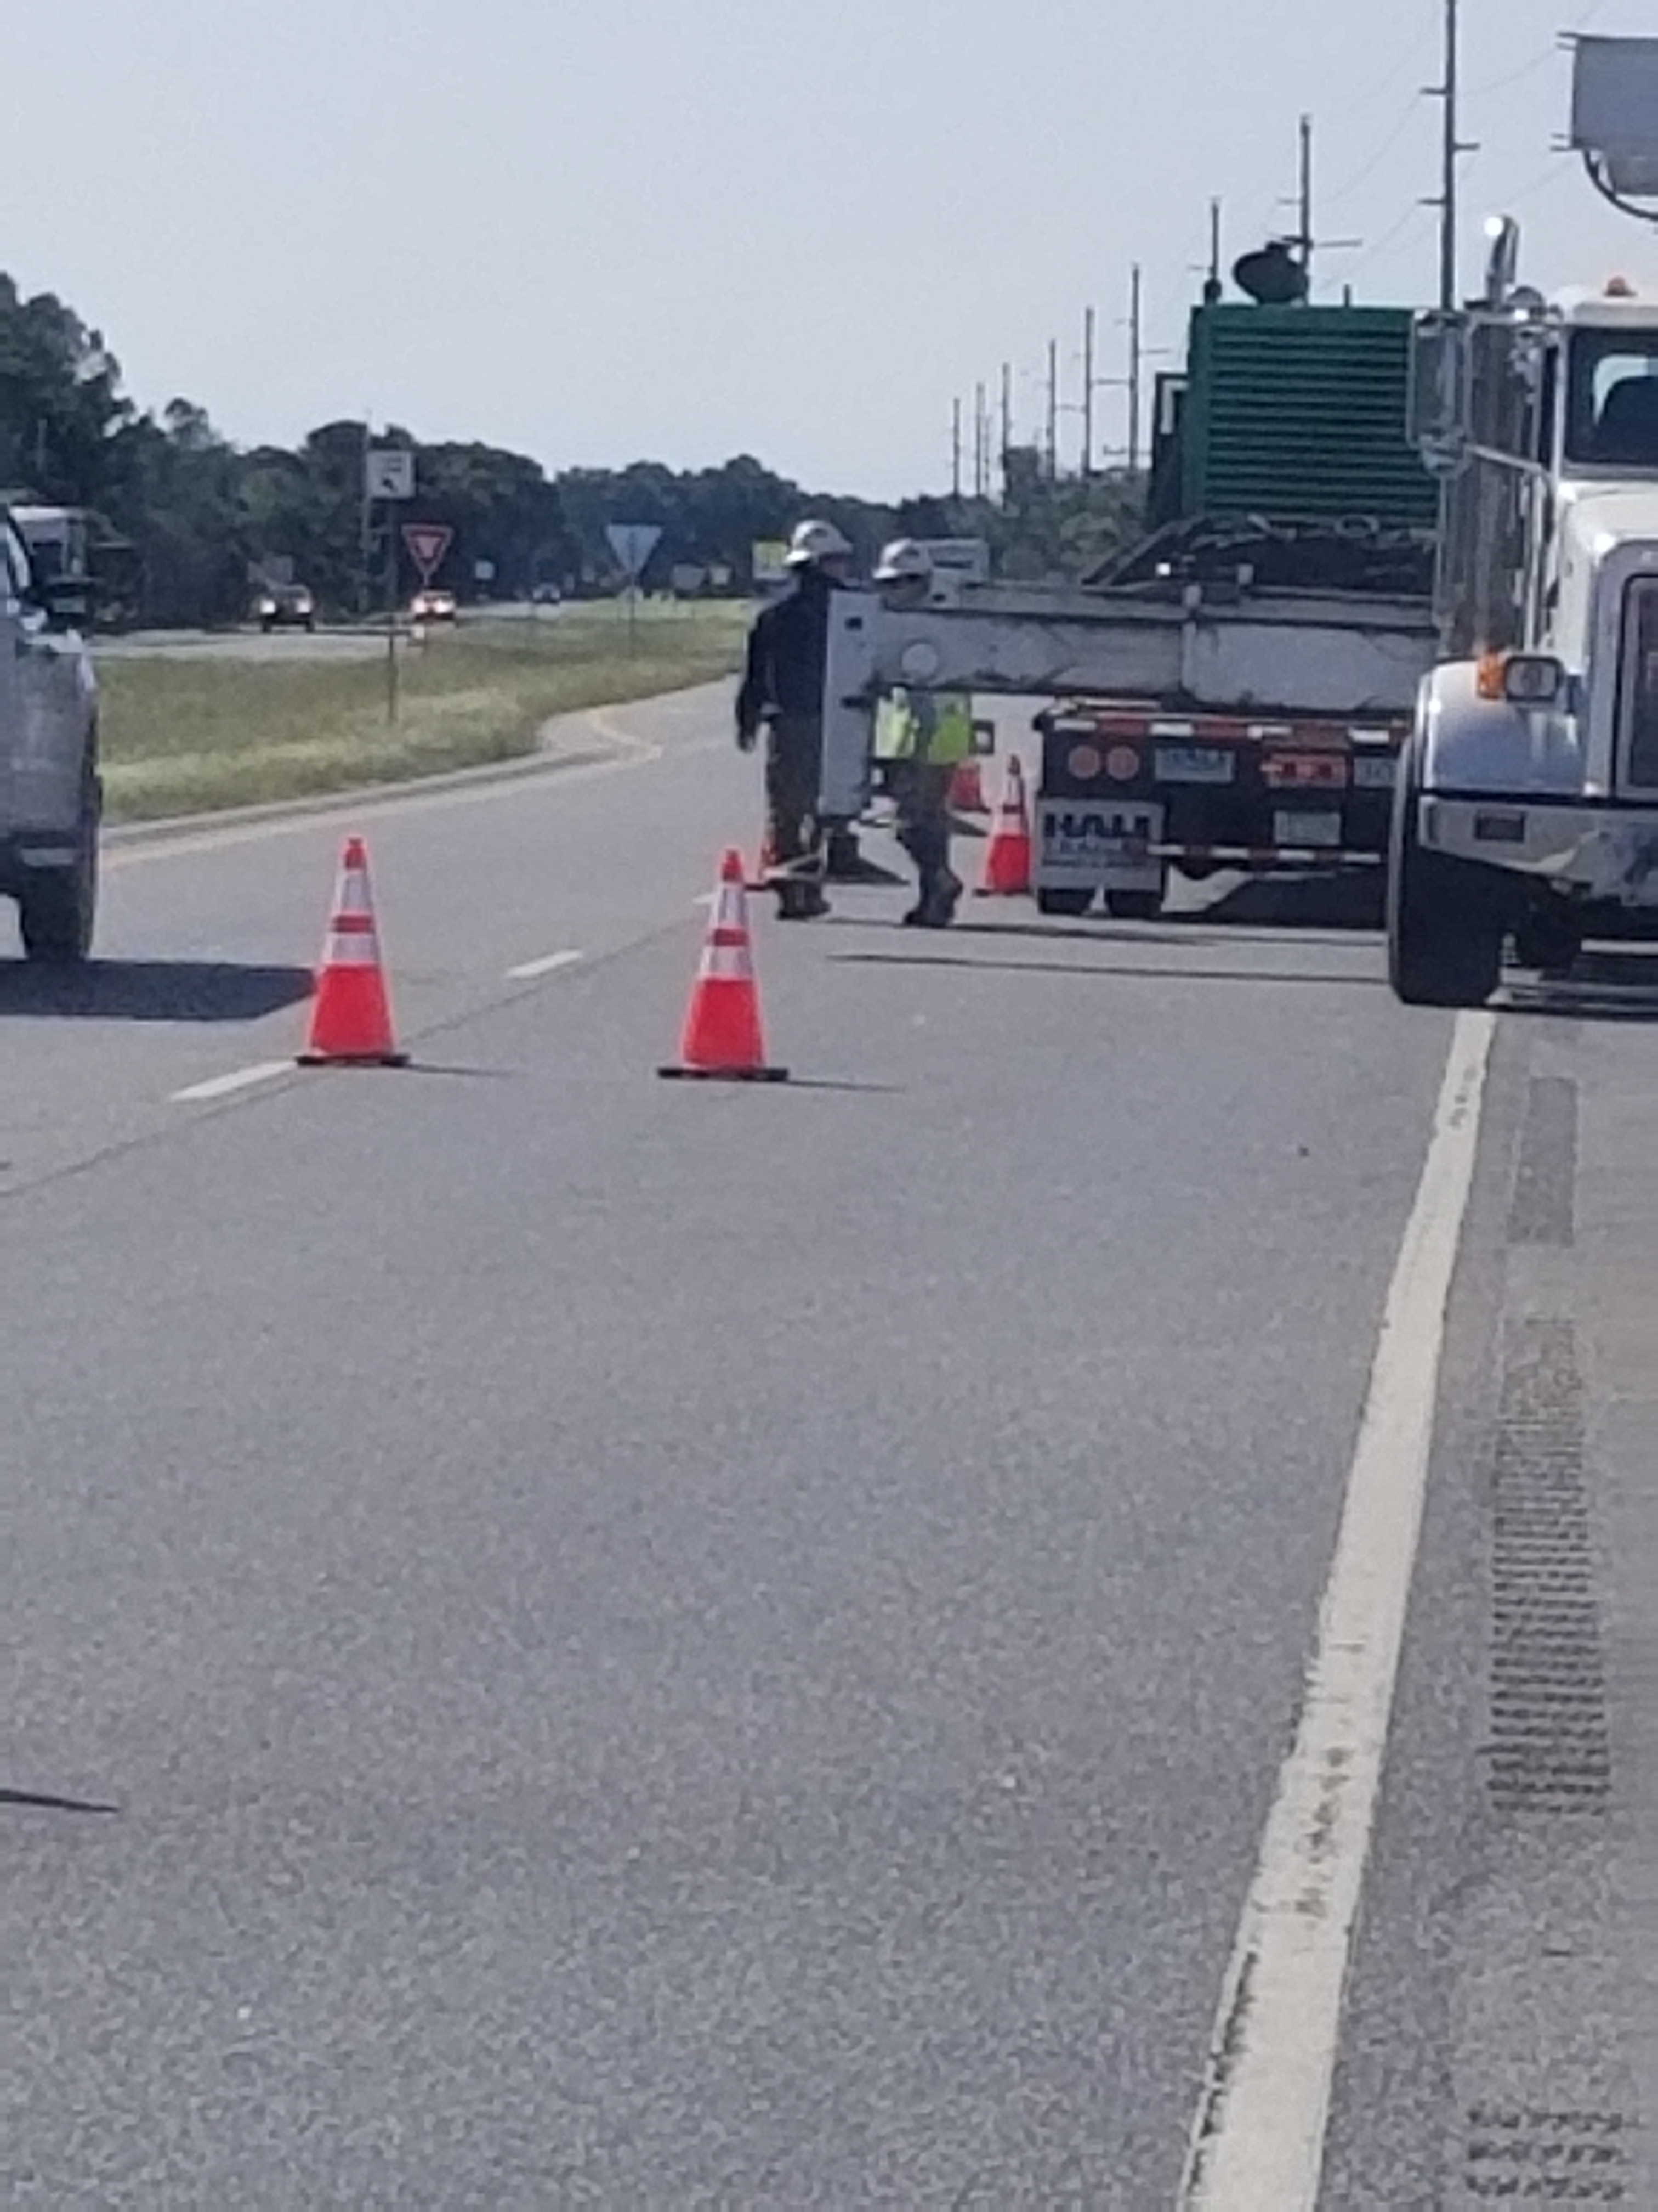
At what point does the contractor have responsibility for the peds.
The moment they block an existing path they too become liable in addition to the permit holder.
In short, it isn’t a recommendation it is a requirement to maintain pedestrian pathways.

Slide 16
Shoulder work
This was permitted as shoulder work utilizing the right travel lane as the ped lane. With an approved ped detour.
Whose responsibility is it to make sure it is set up correctly?
It is the permit holder's responsibility

Slide 17
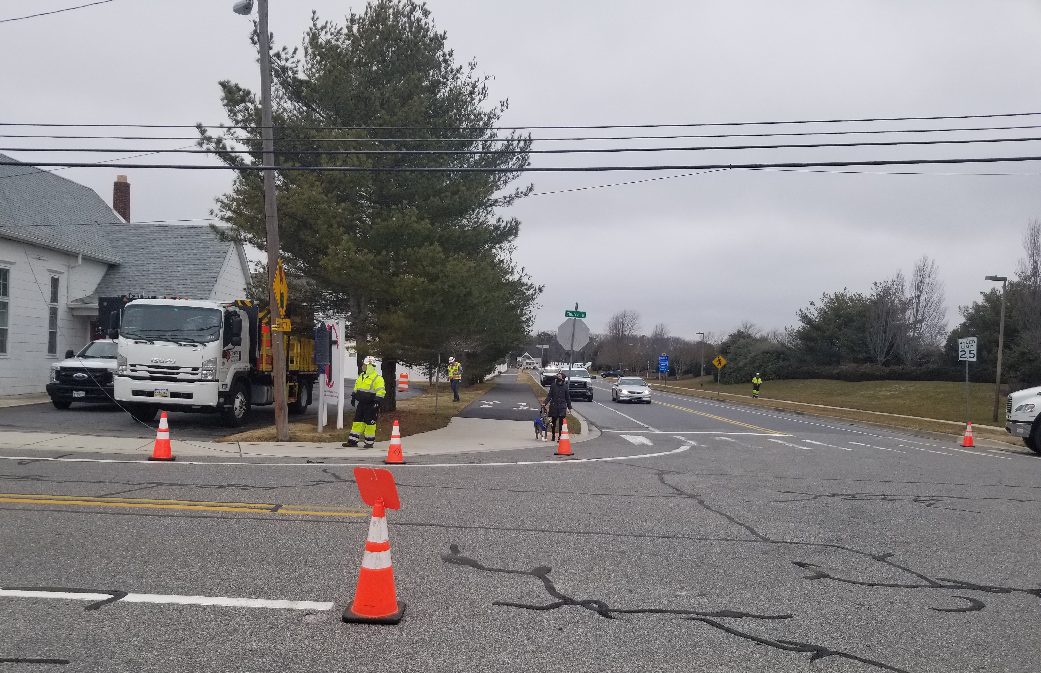
Shoulder work

Slide 18
Expiring permits/work completed
The system sends out a notification in advance of a permit expiring.
When work is completed
Send the District an email with the status of the permit or request an extension or date work was completed.
Send a completion email to the District stating work completed and date completed. **Yes, this process may identify the fact the permit was not called in to commence the work.

Slide 19
Recap/Questions Top 4 issues in 2020
Consultants Submitting on Behalf of a Utility
Incomplete Submittals
PED Detours
Expiring Permits/ Work Completed

